Slide 1
Anxiolytic and hypnotic drugs

Slide 2
drugs differ in the relationship between the dose and the degree of CNS depression.
With the older sedative-hypnotics, as barbiturates., an increase in dose higher than that needed for hypnosis may lead to a state of general anesthesia.
At still higher doses, thes sedativehypnotics may depress respiratory and vasomotor centers in the medulla, leading to coma and death.

Slide 3
Deviations from a linear dose-response relationship, require greater dosage increments to achieve central nervous system depression more than hypnosis.
This appears to be the case for benzodiazepines and for certain newer hypnotics that have a similar mechanism of action.

Slide 4
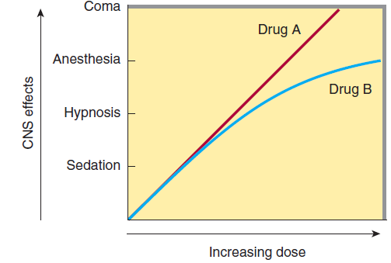

Slide 5
Anxiety
Unpleasant state of tension, apprehension, or uneasiness (a fear that arises from either a known or an unknown source).
The physical symptoms of severe anxiety are similar to those of fear (such as tachycardia, sweating, trembling, and palpitations) and involve sympathetic activation.

Slide 6
sedative (anxiolytic) drugs are drugs that reduce anxiety and exert a calming effect.
hypnotic drugs are drugs that produce drowsiness and encourage the onset and maintenance of a state of sleep.

Slide 7
Hypnotic effects involve more pronounced depression of the central nervous system than sedation, and this can be achieved with many drugs in this class simply by increasing the dose.

Slide 8
Graded dose-dependent depression of central nervous system function is a characteristic of most sedative-hypnotics.

Slide 9
Benzodiazepines
The benzodiazepines are widely used sedative-hypnotics for the treatment of anxiety and insomnia.
Benzodiazepines include Diazepam, Clonazepam, Lorazepam, Chlordiazepoxide, Temazepam, and Midazolam

Slide 10
Mechanism of action
The targets for benzodiazepine actions are the γ-aminobutyric acid (GABAA)receptors neuronal membranes in CNS.
GABA is the major inhibitory neurotransmitter in the central nervous system (CNS).

Slide 11
Binding of GABA to its receptor triggers an opening of the chloride ion channel, allowing chloride through the pore.
The influx of chloride ions causes hyperpolarization of the neuron and decreases neurotransmission by inhibiting the formation of action potentials.

Slide 12
Benzodiazepines modulate GABA effects by binding to a specific, high-affinity site and increase the frequency of channel openings produced by GABA.

Slide 14
benzodiazepines Actions
All BNZS exhibit the following actions:
1. Sedation: At low doses, the benzodiazepines are anxiolytic. They reduce anxiety by selectively enhancing GABAergic transmission in neurons thereby inhibiting neuronal circuits in the limbic system of the brain.
2. Sedative/hypnotic: All benzodiazepines have sedative and calming properties, and can produce hypnosis at higher doses.

Slide 15
3. Anterograde amnesia: inability to remember events occurring during the drug’s duration of action.
4. Anesthesia: high doses of certain sedative-hypnotics depress the central nervous system to the point of general anesthesia.
This effect depends mainly on the physicochemical properties that determine its rapidity of onset and duration of effect.

Slide 16
5. Anticonvulsant: Several benzodiazepines have anticonvulsant activity.
6. Muscle relaxant: At high doses, the benzodiazepines relax the spasticity of skeletal muscle, probably by increasing presynaptic inhibition in the spinal cord, where the α2-GABAA receptors are largely located. Baclofen is a muscle relaxant that is believed to affect GABA receptors at the level of the spinal cord.

Slide 17
Therapeutic uses
small differences in their relative anxiolytic, anticonvulsant, and sedative properties.
the duration of action varies widely among this group, and pharmacokinetic considerations are often important in choosing one benzodiazepine over another.

Slide 18
1. Anxiety disorders:
treatment of differnet types of anxieties:
anxiety symptoms secondary to panic disorder,
generalized anxiety disorder (GAD),
social anxiety disorder, performance anxiety,
posttraumatic stress disorder, obsessive–compulsive disorder, and extreme anxiety associated with phobias, such as fear of flying.

Slide 19
For sedation and amnesia before and during medical and surgical procedures
Because of their addiction potential, they should only be used for short periods of time.
The longer-acting agents, such as clonazepam, lorazepam, and diazepam, are often preferred in those patients with anxiety that may require prolonged treatment.

Slide 20
2. Sleep disorders
Insomania: is a sleep disorder characterized by inability to anitiate or maintain sleep and can be associated with problem during day time
A few of the benzodiazepines are useful as hypnotic agents. These agents decrease the latency to sleep onset and increase stage II of non–rapid eye movement (REM) sleep. Both REM sleep and slow-wave sleep are decreased.

Slide 21
The drug selected should be one that provides sleep of fairly rapid onset (decreased sleep latency) and sufficient duration, with minimal “hangover” effects such as drowsiness, dysphoria, and mental or motor depression the following day.

Slide 22
Commonly prescribed benzodiazepines for sleep disorders include intermediate-acting lorazepam and short-acting triazolam.
Long-acting flurazepam, Diazepam are rarly used, due to its extended half-life, which may result in excessive daytime sedation and accumulation of the drug.

Slide 23
3. Amnesia: used as premedication for anxiety-provoking and unpleasant procedures, such as endoscopy, dental procedures, angioplasty, and prior to anesthesia.
4. Seizures: Clonazepam is used for certain types of seizures, whereas lorazepam and diazepam are the drugs of choice in terminating status epilepticus.

Slide 24
5. Muscular disorders: Diazepam is useful in the treatment of skeletal muscle spasms, such as occur in muscle strain, and in treating spasticity from degenerative disorders, such as multiple sclerosis and cerebral palsy.

Slide 25
Pharmacokinetics
1. Absorption and distribution:
The benzodiazepines are lipophilic.
completely absorbed after oral administration.
Lipophilicity determining the rate at which the sedative-hypnotic enters the central nervous system.
This property is responsible for the rapid onset of CNS effects of triazolam.

Slide 26
2. Duration of action: The half-lives of the benzodiazepines are important clinically, because the duration of action may determine the therapeutic usefulness.
Short: trizolam
Intermediate: lorazepam
long-acting groups: diazepam

Slide 27
Adverse effects
Drowsiness and confusion are common.
Ataxia occurs at high doses.
Cognitive impairment.
other CNS depressants enhance the sedative–hypnotic effects of the benzodiazepines.

Slide 28
Dependence
Psychological and physical dependence on benzodiazepines can develop if high doses of the drugs are given for a prolonged period.
Abrupt discontinuation of the benzodiazepines results in withdrawal symptoms, including confusion, anxiety, agitation, restlessness, insomnia, tension.

Slide 29
Barbiturates
The sedative–hypnotic action of the barbiturates is due to their interaction with GABA_{A} receptors, which enhances GABAergic transmission.
the binding site of barbiturates on the GABA receptor is distinct from that of the benzodiazepines.

Slide 30
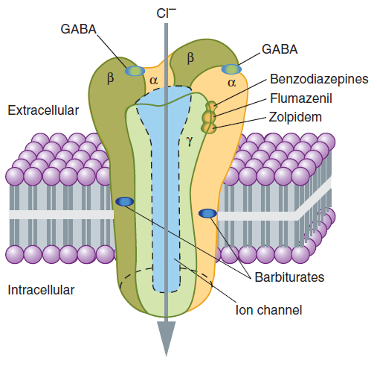

Slide 31
Barbiturates potentiate GABA action on chloride entry into the neuron by prolonging the duration of the chloride channel openings.

Slide 32
In addition, barbiturates can block excitatory glutamate receptors.
pentobarbital also block high-frequency sodium channels.
barbiturates have been largely replaced by the benzodiazepines, primarily because barbiturates induce tolerance and physical dependence and are associated with very severe withdrawal symptoms.

Slide 33
Actions
Depression of CNS: At low doses, the barbiturates produce sedation (have a calming effect and reduce excitement).
At higher doses, the drugs cause hypnosis, followed by anesthesia (loss of feeling or sensation), and, finally, coma and death.
any degree of depression of the CNS is possible, depending on the dose. Chronic use leads to tolerance.
2.

Slide 34
2. Respiratory depression: Barbiturates suppress the hypoxic and chemoreceptor response to CO2, and overdosage is followed by respiratory depression and death.

Slide 35
Therapeutic uses
1. Anesthesia: thiopental used intravenously to induce anesthesia.
2. Anticonvulsant: Phenobarbital has specific anticonvulsant activity that is distinguished from the nonspecific CNS depression. It is used in long-term management of tonic–clonic seizures.
phenobarbital may be used for the treatment of refractory status epilepticus.

Slide 36
3. Sedative/hypnotic: Barbiturates have been used as mild sedatives to relieve anxiety, nervous tension, and insomnia. the use of barbiturates for insomnia is no longer generally accepted, given their adverse effects and potential for tolerance.

Slide 37
Adverse effects
Barbiturates cause drowsiness, impaired concentration, and mental and physical sluggishness.
Hypnotic doses of barbiturates produce a drug “hangover” that may lead to impaired ability to function normally for many hours after waking.

Slide 38
Barbiturates induce cytochrome P450 (CYP450), Therefore, chronic barbiturate administration diminishes the action of many drugs that are metabolized by the CYP450 system.

Slide 39
Abrupt withdrawal from barbiturates may cause tremors, anxiety, weakness, restlessness, nausea and vomiting, seizures, delirium, and cardiac arrest. Withdrawal is much more severe than that associated with opiates and can result in death.

Slide 40
Death may also result from overdose. Severe depression of respiration is coupled with central cardiovascular depression and results in a shock-like condition, infrequent breathing. Treatment includes supportive care and gastric decontamination for recent ingestions.

